Slide 1


PROGRESS PRESENTATION ON RECOMMENDATION UPSKILLING
Nirajan Bekoju

Slide 2
BASIC OVERVIEW
Week 1, 2, 3 (Completed)
Week 4 (In progress)
Week 5 (Not started yet)

Slide 3
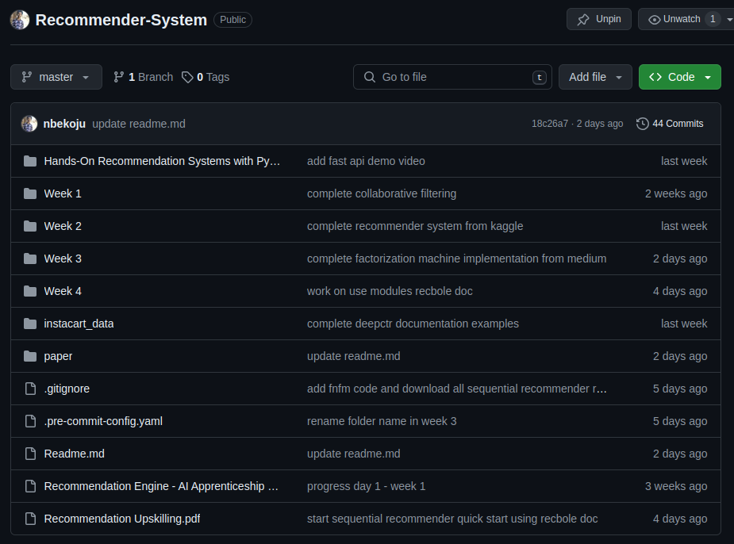
GITHUB REPOSITORY
https://github.com/nbekoju/Recommender-System

Slide 4
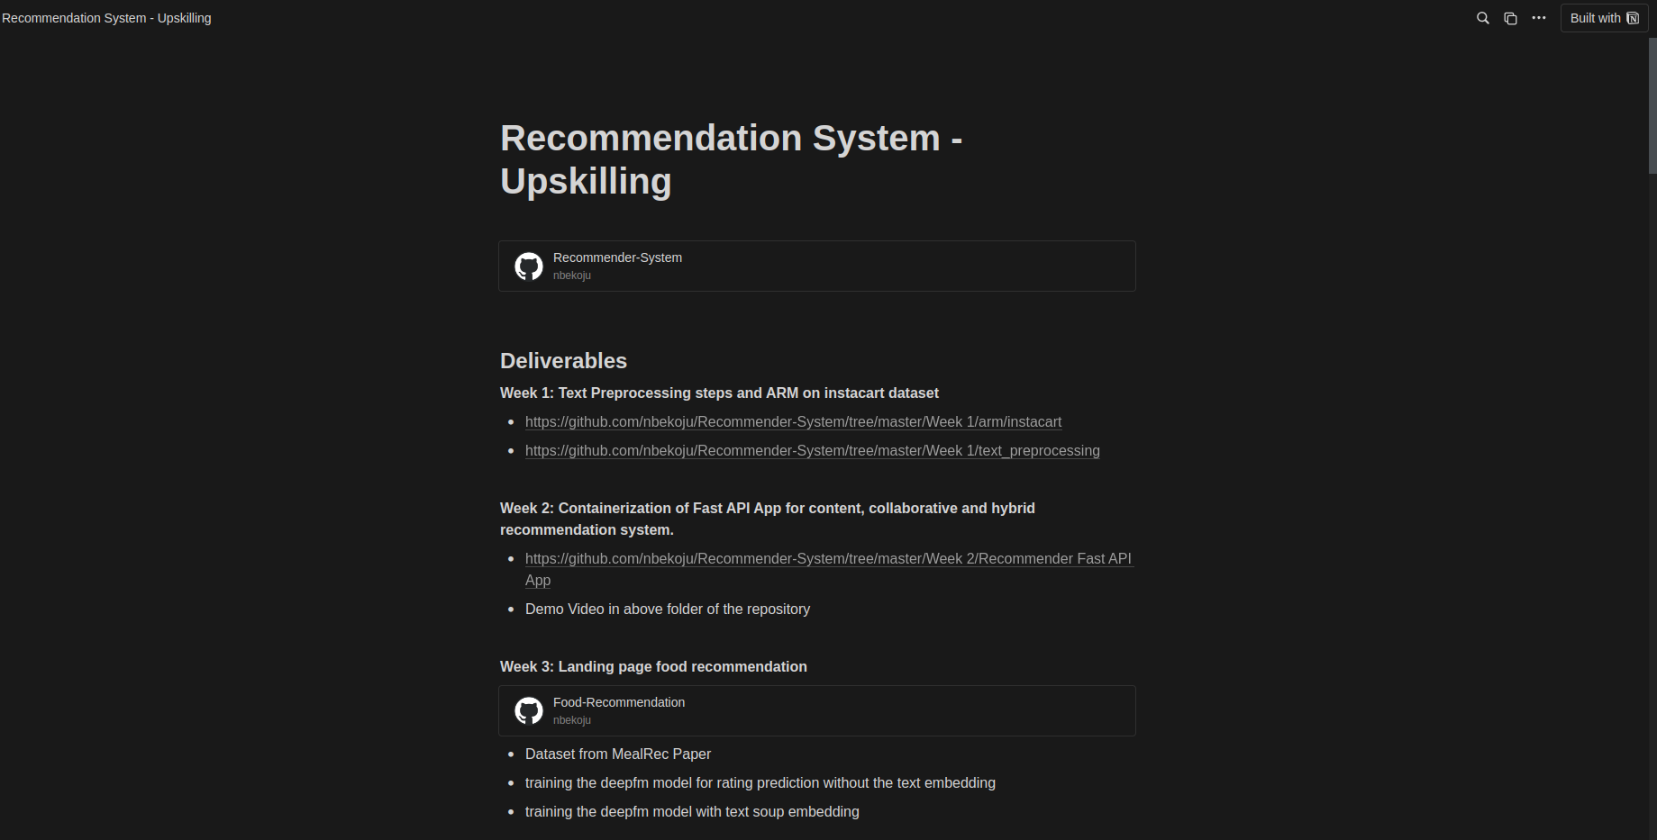
MY UPSKILLING JOURNEY - RECOMMENDATION SYSTEM
https://nirajanbekoju.notion.site/Recommendation-System-Upskilling-487af8811c8d46d2a59049b9a5c9f4f1
Resources
Code Link
Research Paper Review

Slide 5
WEEK 1 - RESOURCE EXPLORATION
Text Preprocessing
Tokenization, stemming, lemmatization, stop words and punctuation removal
Removal of URLs, HTML Tags
Chat Word Conversion (AFK →Away From Keyboard)
Text Encoding
BOW, TF-IDF, Word2Vec, sBERT
Association Rule Mining (ARM)
Apriori Method
FP-Growth Method

Slide 6
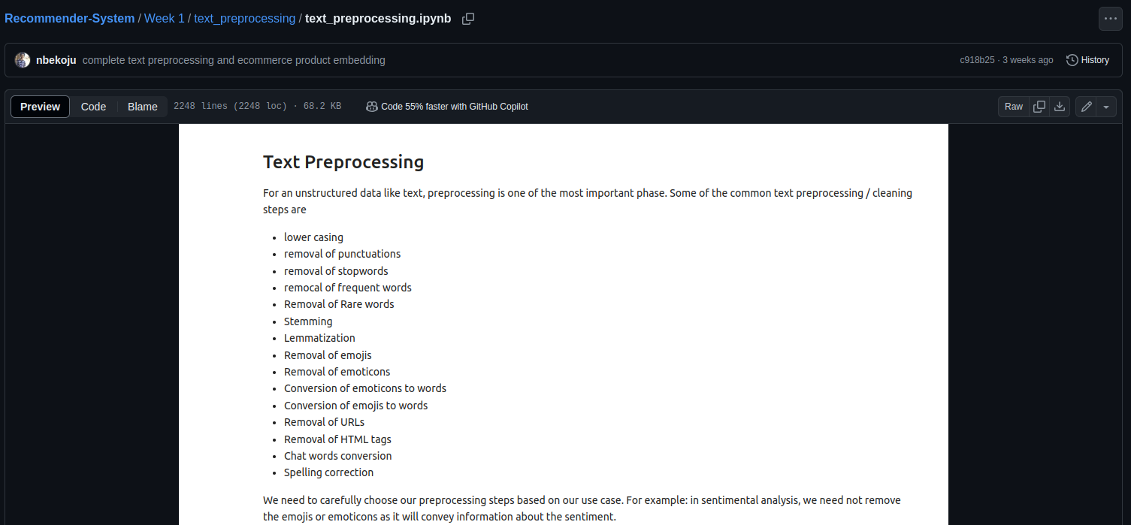
WEEK 1 - DELIVERABLES 1 : Text Preprocessing

Slide 7
WEEK 1 - DELIVERABLE 2
ARM ON INSTACART DATASET

Slide 8
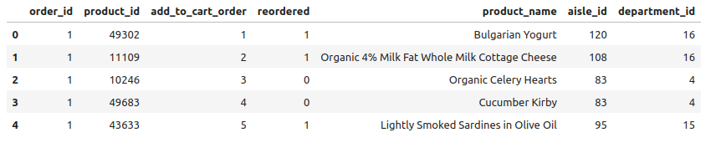
ARM ON INSTACART DATASET : Data Preparation
Instacart Data shows order id and its corresponding product metadata

Slide 9
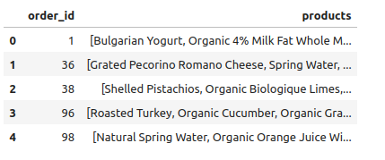
ARM ON INSTACART DATASET : Data Preparation
For an order, get the list of product from previous data

Slide 10
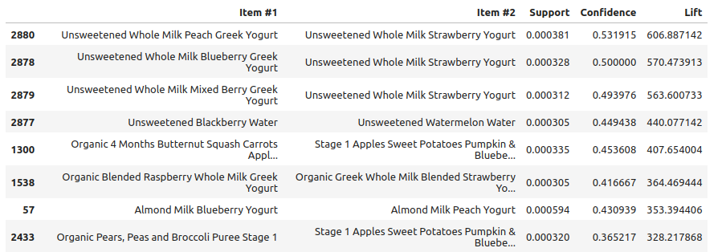
ARM ON INSTACART DATASET : RESULT
ARM using apriori shows association between items in descending order by lift

Slide 11
WEEK 2

Slide 12
WEEK 2 - RESOURCE EXPLORATION
Content-based, Collaborative-based and Hybrid Recommendation
These topics are covered by Book: Hands on Recommendation System With Python (Chapter 4, 5, 6, 7)
Cold Start and Long Tail Problems
Evaluation Metrics
Deployment using FastAPI
Containerization using Docker

Slide 13
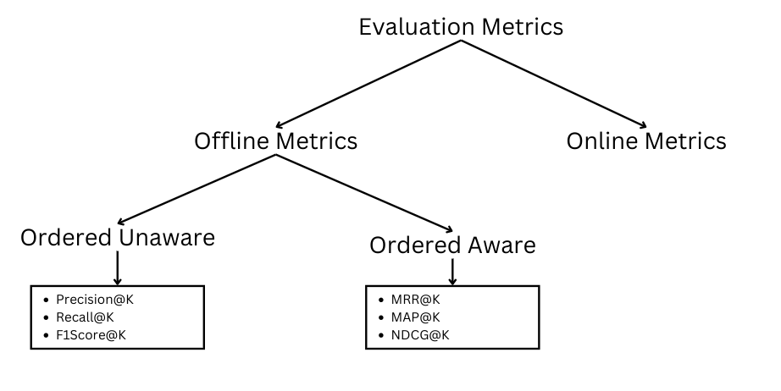
WEEK 2 - EVALUATION METRICS
MRR → Mean Reciprocal Rank
MAP → Mean Average Precision
NDCG →Normalized Discouted Cumulative Gain
Spotify uses MRR@30 as the evaluation metric

Slide 14
WEEK 2 - DELIVERABLES
FastAPI Application:
Content-based, Collaborative-based and Hybrid
Movie Recommendation System

Slide 15

WEEK 2 - DELIVERABLE : DEMO VIDEO

Slide 16
WEEK 2 - DELIVERABLE : DEMO VIDEO

Slide 17
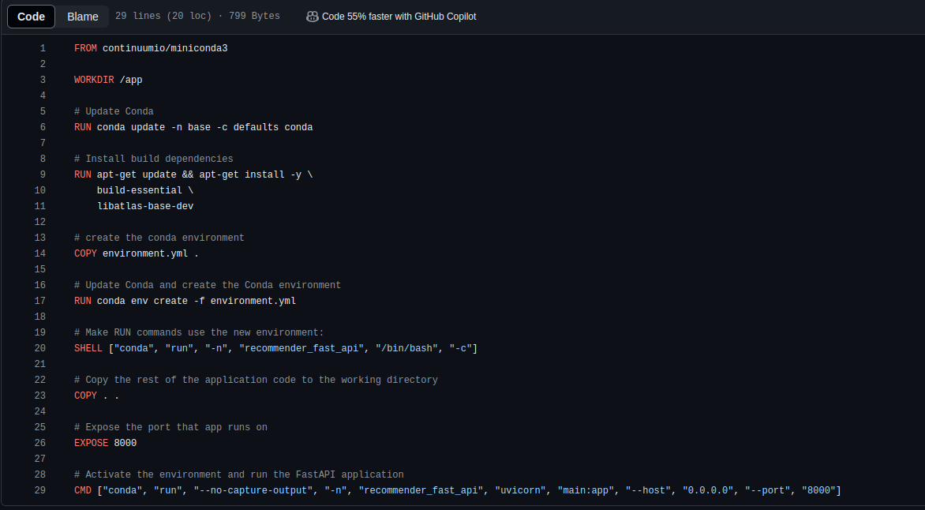
WEEK 2 - DELIVERABLE : DOCKERFILE

Slide 18
WEEK 3

Slide 19
WEEK 3 - RESOURCE EXPLORATION
Factorization Machine
Deep Factorization Machine
Neural Factorization Machine
Field Aware Neural Factorization Machine
DeepCTR
SparseFeat vs DenseFeat
Embeddings
Converting data to model format
Training, Evaluation and Inference
MLFlow

Slide 20
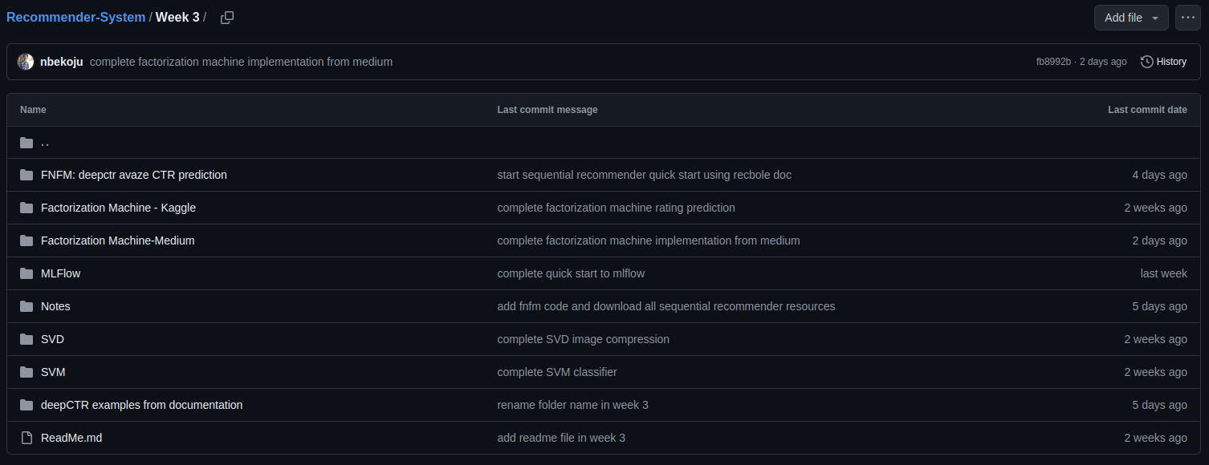
WEEK 3 - REPOSITORY OVERVIEW

Slide 21
WEEK 3 - DELIVERABLES
LANDING PAGE FOOD RECOMMENDATION
USING deepCTR
https://github.com/nbekoju/Food-Recommendation
Dataset: https://github.com/WUT-IDEA/MealRec
DeepFM: https://arxiv.org/abs/1703.04247

Slide 22
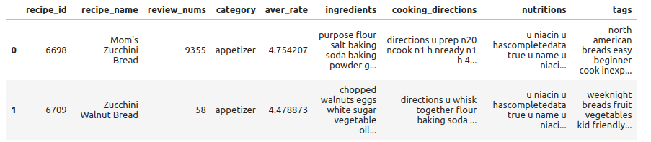
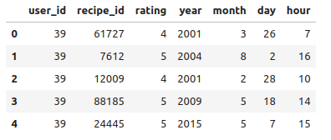
LANDING PAGE FOOD RECOMMENDATION: DATA PREPARATION
Recipe Data
Text preprocessing
User Recipe Interaction Data
Date to year, month…

Slide 23
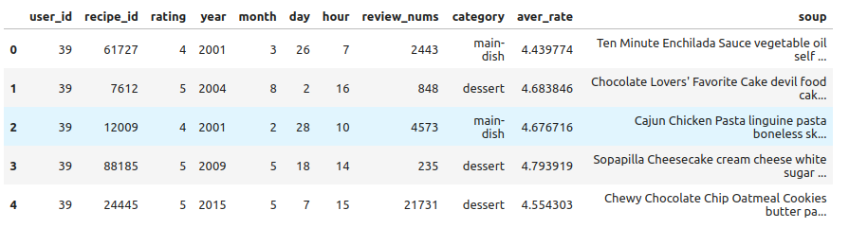
LANDING PAGE FOOD RECOMMENDATION: DATA PREPARATION
Join the two dataset
Merge all text data into soup column
Use sBERT for text encoding of soup column

Slide 24
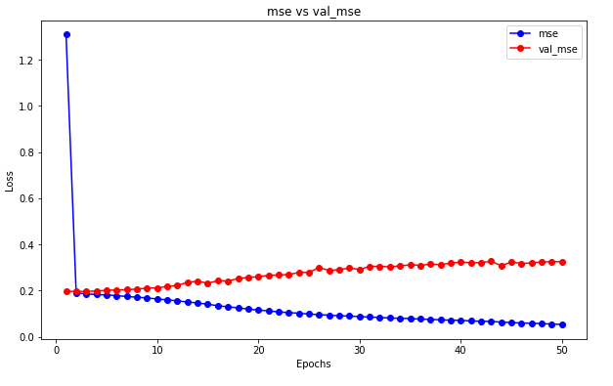
LANDING PAGE FOOD RECOMMENDATION: TRAINING WITHOUT SOUP
TEST MSE : 0.3246

Slide 25
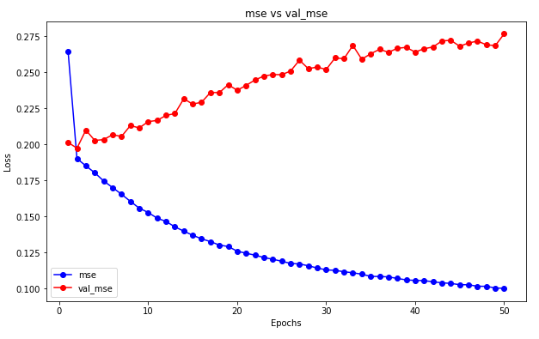
LANDING PAGE FOOD RECOMMENDATION: TRAINING WITH SOUP
TEST MSE : 0.282

Slide 26
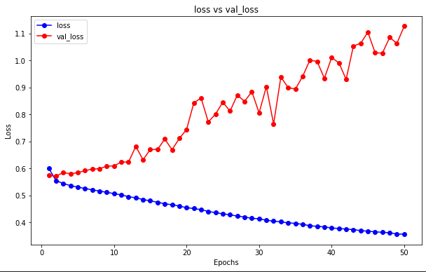
LANDING PAGE FOOD RECOMMENDATION: TRAINING WITH SOUP AS A BINARY TASK
Loss = Binary CrossEntropy
TEST MSE : 0.256

Slide 27
WEEK 4 : Sequential Recommender System

Slide 28
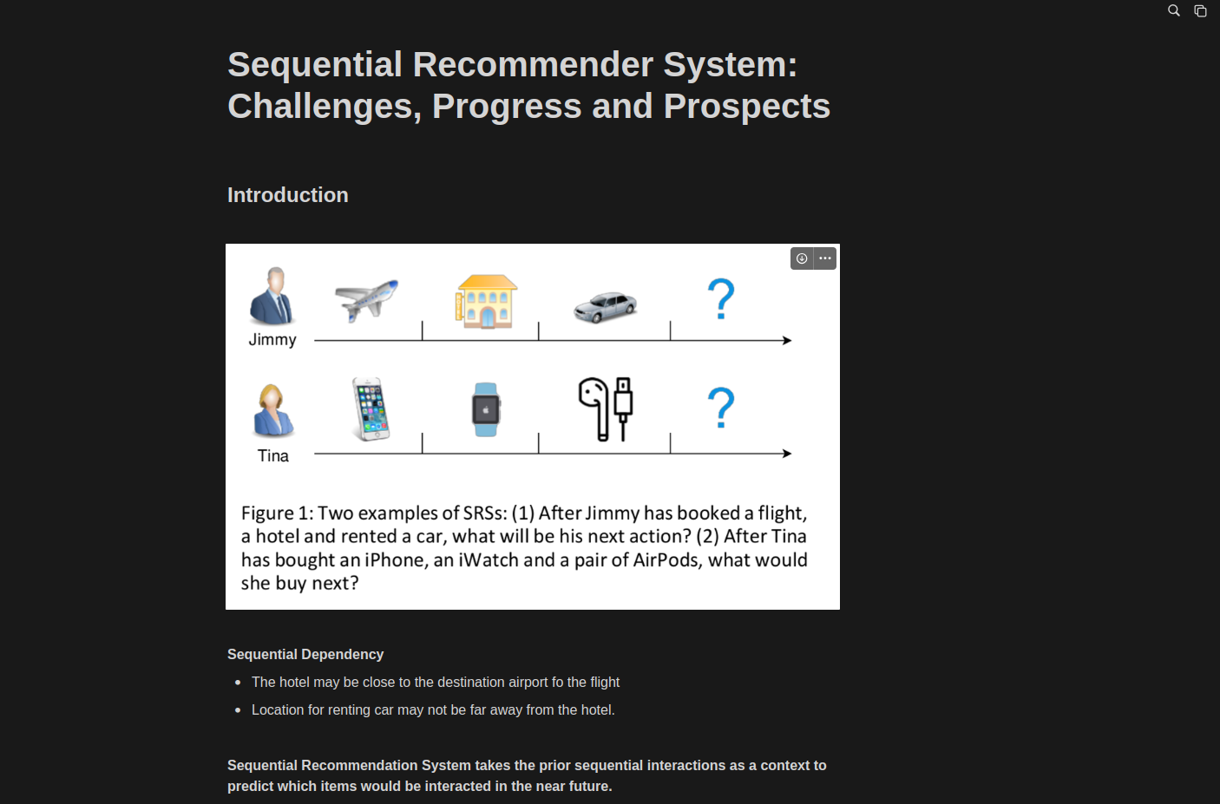
WEEK 4 - Sequential Recommender System: Challenges, Progress and Prospects
https://nirajanbekoju.notion.site/Sequential-Recommender-System-Challenges-Progress-and-Prospects-11ffcfbce6634de196e68bc3b063f3b4

Slide 29
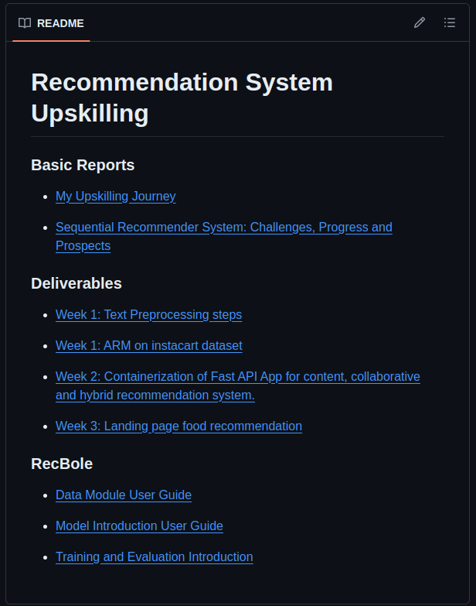
WEEK 4 - RecBole Notes

Slide 30
THANK YOU

